Slide 1

Introduction to Time Complexity
Lecture-2
Subject – Data Structure and Algorithms
Class – B.Tech CSE
3rd Semester
by
Dr. Monika Sachdeva
I KG Punjab Technical University, Mohali Campus-I

Slide 2
ALGORITHM DEFINITION
A finite set of statements that guarantees an optimal solution in finite interval of time

Slide 3
GOOD ALGORITHMS?
Run in less time
Consume less memory
But computational resources (time complexity) is usually more important

Slide 4
MEASURING EFFICIENCY
The efficiency of an algorithm is a measure of the amount of resources consumed in solving a problem of size n.
  The resource we are most interested in is time
  We can use the same techniques to analyze the consumption of other resources, such as memory space.
It would seem that the most obvious way to measure the efficiency of an algorithm is to run it and measure how much processor time is needed
Is it correct ?

Slide 5
RUNNING TIME OF AN ALGORITHM
Depends upon
    Input Size
    Nature of Input
Generally time grows with size of input, so running time of an algorithm is usually measured as function of input size.
Running time is measured in terms of number of steps/primitive operations performed
Independent from machine, OS

Slide 6
FINDING RUNNING TIME OF AN ALGORITHM / ANALYZING AN ALGORITHM
Running time is measured by number of steps/primitive operations performed
Steps means elementary operation like
  ,+, *,<, =, A[i] etc
We will measure number of steps taken in term of size of input

Slide 7
SIMPLE EXAMPLE (1)
// Input: int A[N], array of N integers
// Output: Sum of all numbers in array A
int Sum(int A[], int N)
{
int s=0;
for (int i=0; i< N; i++)
s = s + A[i];
return s;
}
How should we analyse this?

Slide 8
SIMPLE EXAMPLE (2)
// Input: int A[N], array of N integers
// Output: Sum of all numbers in array A
int Sum(int A[], int N){
int s=0;
for (int i=0; i< N; i++)
s = s + A[i];
return s;
}
1
2
3
4
5
1,2,8: Once
3,4,5,6,7: Once per each iteration
of for loop, N iteration
Total: 5N + 3
The complexity function of the
algorithm is : f(N) = 5N +3
6
7
8

Slide 9
SIMPLE EXAMPLE (3) GROWTH OF 5N+3
Estimated running time for different values of N:
N = 10 => 53 steps
N = 100 => 503 steps
N = 1,000 => 5003 steps
N = 1,000,000 => 5,000,003 steps
As N grows, the number of steps grow in linear proportion to N for this function “Sum”

Slide 10
WHAT DOMINATES IN PREVIOUS EXAMPLE?
What about the +3 and 5 in 5N+3?
  As N gets large, the +3 becomes insignificant
  5 is inaccurate, as different operations require varying amounts of time and also does not have any significant importance
What is fundamental is that the time is linear in N.
Asymptotic Complexity: As N gets large, concentrate on the
highest order term:
  Drop lower order terms such as +3
  Drop the constant coefficient of the highest order term i.e. N

Slide 11
ASYMPTOTIC COMPLEXITY
The 5N+3 time bound is said to "grow asymptotically" like N
This gives us an approximation of the complexity of the algorithm
Ignores lots of (machine dependent) details, concentrate on the bigger picture

Slide 12
COMPARING FUNCTIONS: ASYMPTOTIC NOTATION
Big Oh Notation: Upper bound
Omega Notation: Lower bound
Theta Notation: Average bound

Slide 13
BIG OH NOTATION [1]
If f(N) and g(N) are two complexity functions, we say
f(N) = O(g(N))
(read "f(N) is order g(N)", or "f(N) is big-O of g(N)")
if there are constants c and N₀ such that for N > N₀,
f(N) ≤ c * g(N)
for all sufficiently large N.

Slide 14
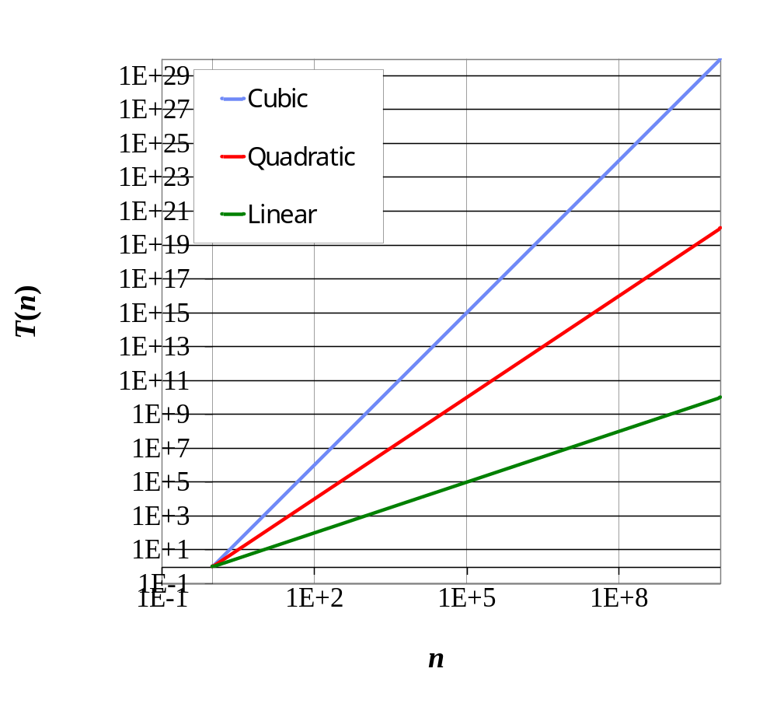
SEVEN IMPORTANT FUNCTIONS
Seven functions that often appear in algorithm analysis:
  Constant ≈ 1
  Logarithmic ≈ log n
  Linear ≈ n
  N-Log-N ≈ n log n
  Quadratic ≈ n²
  Cubic ≈ n³
  Exponential ≈ 2^{n}
In adjacent chart, the slope of the line corresponds to the growth rate of the function

Slide 15
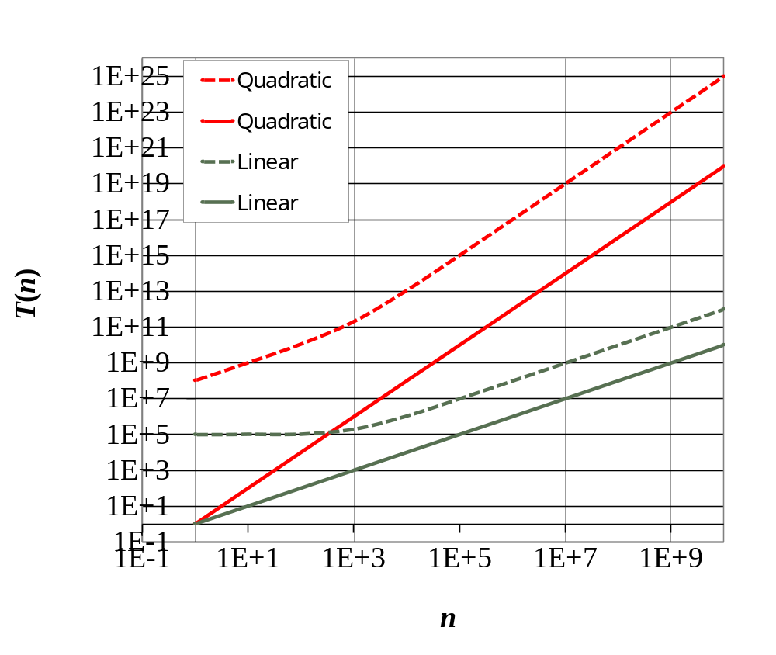
CONSTANT FACTORS
The growth rate is not affected by
  constant factors or
  lower-order terms
Examples
  10²n + 10⁵ is a linear function
  10⁵n² + 10⁸n is a quadratic function

Slide 16
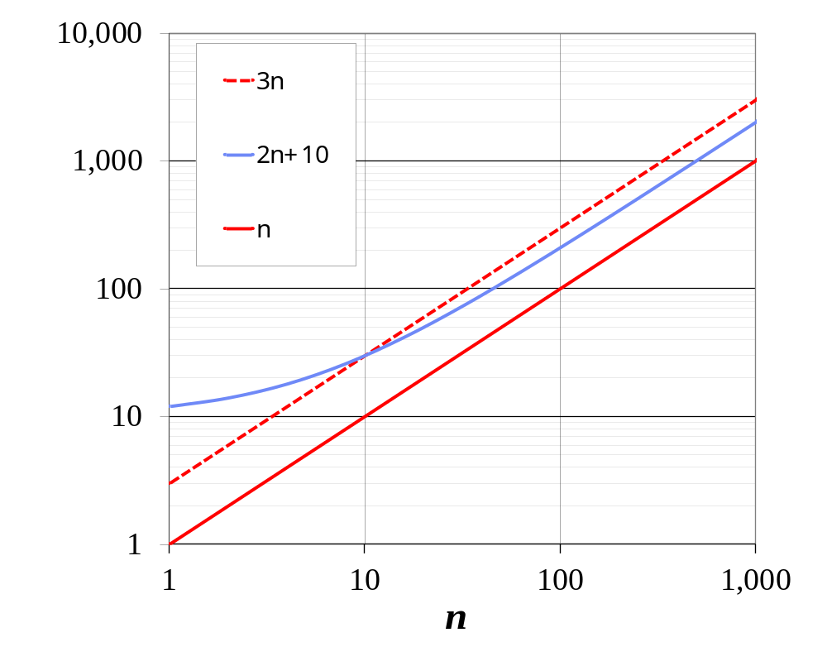
BIG-OH NOTATION
Given functions f(n) and g(n), we say that f(n) is O(g(n)) if there are positive constants
c and n₀ such that
f(n) ≤ cg(n) for n ≥ n₀
Example: 2n + 10 is O(n)
  2n + 10 ≤ cn
  (c − 2) n ≥ 10
  n ≥ 10/(c − 2)
  Pick c = 3 and n₀ = 10

Slide 17
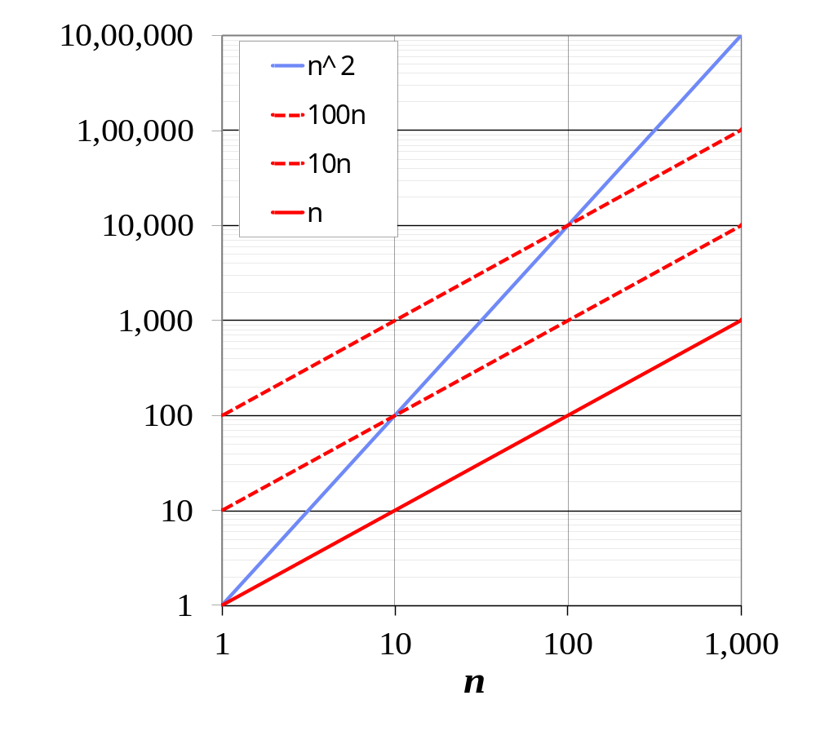
BIG-OH EXAMPLE
Example: the function n² is not O(n)
  n² ≤ cn
  n ≤ c
  The above inequality cannot be satisfied since c must be a constant

Slide 18


More Big-Oh Examples
7n-2
  7n-2 is O(n)
  need c > 0 and n₀ ≥ 1 such that 7n-2 ≤ c•n for n ≥ n₀
  this is true for c = 7 and n₀ = 1
3n³ + 20n² + 5
  3n³ + 20n² + 5 is O(n³)
  need c > 0 and n₀ ≥ 1 such that 3n³ + 20n² + 5 ≤ c•n³ for n ≥ n₀
  this is true for c = 4 and n₀ = 21
3 log n + 5
  3 log n + 5 is O(log n)
  need c > 0 and n₀ ≥ 1 such that 3 log n + 5 ≤ c•log n for n ≥ n₀
  this is true for c = 8 and n₀ = 2

Slide 19
BIG-OH AND GROWTH RATE
The big-Oh notation gives an upper bound on the growth rate of a function
The statement “f(n) is O(g(n))” means that the growth rate of f(n) is no more than the growth rate of g(n)
We can use the big-Oh notation to rank functions according to their growth rate
 | f(n) is O(g(n)) | g(n) is O(f(n))
g(n) grows more | Yes | No
f(n) grows more | No | Yes
Same growth | Yes | Yes

Slide 20
BIG-OH RULES
If is f(n) a polynomial of degree d, then f(n) is O(n^{d}), i.e.,
  Drop lower-order terms
  Drop constant factors
Use the smallest possible class of functions
  Say “2n is O(n)” instead of “2n is O(n²)”
Use the simplest expression of the class
  Say “3n + 5 is O(n)” instead of “3n + 5 is O(3n)”

Slide 21
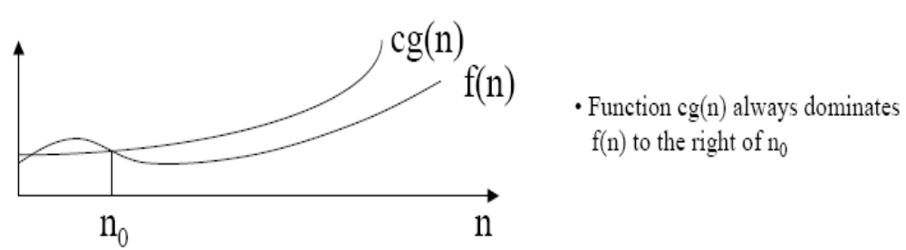
BIG OH NOTATION [2]

Slide 22
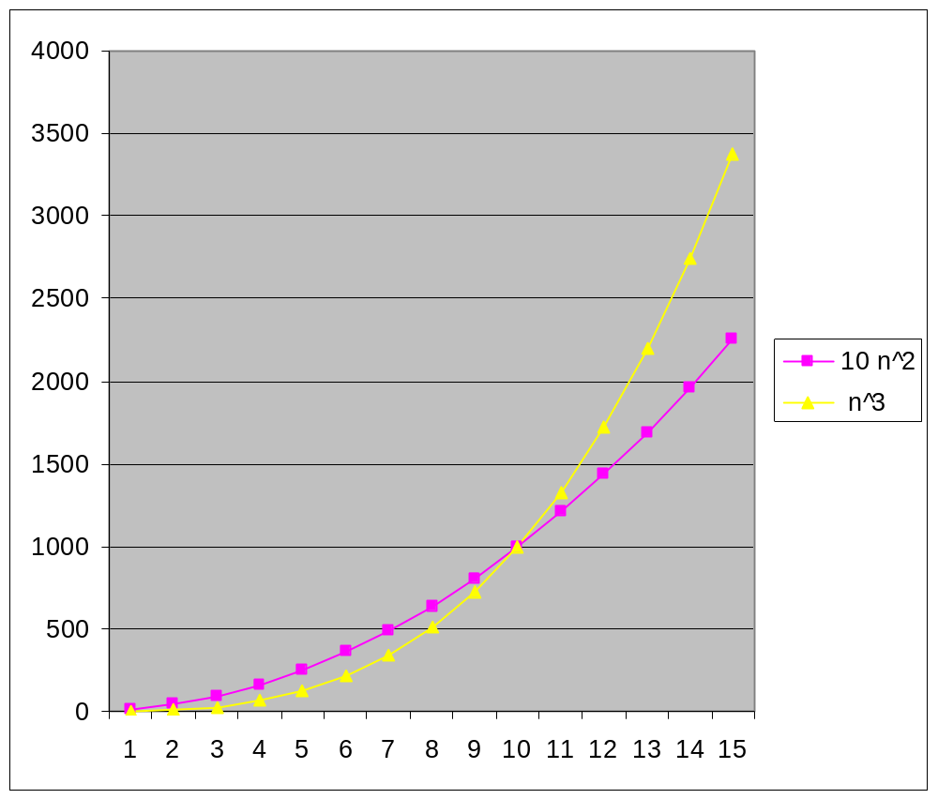
EXAMPLE (2): COMPARING FUNCTIONS
Which function is better?
10 n² Vs n³

Slide 23
COMPARING FUNCTIONS
As inputs get larger, any algorithm of a smaller order will be more efficient than an algorithm of a larger order
0.05 N² = O(N²)
3N = O(N)
Time (steps)
N = 60
Input (size)

Slide 24
BIG-OH NOTATION
Even though it is correct to say “7n - 3 is O(n³)”, a better statement is “7n - 3 is O(n)”, that is, one should make the approximation as tight as possible
Simple Rule:
Drop lower order terms and constant factors
  7n-3 is O(n)
  8n²log n + 5n² + n is O(n²log n)

Slide 25
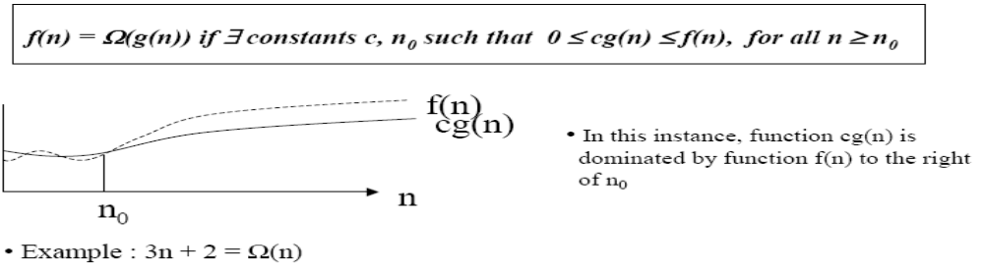
BIG OMEGA NOTATION
If we wanted to say “running time is at least…” we use Ω
Big Omega notation, Ω, is used to express the lower bounds on a function.
If f(n) and g(n) are two complexity functions then we can say:
f(n) is Ω(g(n)) if there exist positive numbers c and n₀ such that 0<=f(n)>=cΩ (n) for all n>=n₀

Slide 26
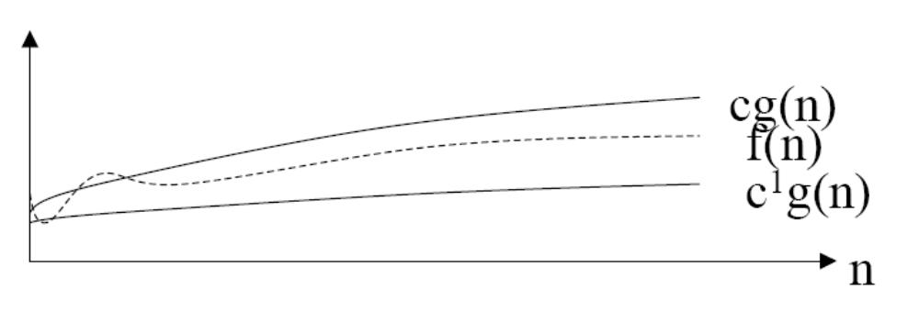
BIG THETA NOTATION
If we wish to express tight bounds we use the theta notation, Θ
f(n) = Θ(g(n)) means that f(n) = O(g(n)) and f(n) = Ω(g(n))

Slide 27
WHAT DOES THIS ALL MEAN?
If f(n) = Θ(g(n)) we say that f(n) and g(n) grow at the same rate, asymptotically
If f(n) = O(g(n)) and f(n) ≠ Ω(g(n)), then we say that f(n) is asymptotically slower growing than g(n).
If f(n) = Ω(g(n)) and f(n) ≠ O(g(n)), then we say that f(n) is asymptotically faster growing than g(n).

Slide 28
WHICH NOTATION DO WE USE?
To express the efficiency of our algorithms which of the three notations should we use?
As computer scientist we generally like to express our algorithms as big O since we would like to know the upper bounds of our algorithms.
Why?
If we know the worse case then we can aim to improve it and/or avoid it.

Slide 29
PERFORMANCE CLASSIFICATION
f(n) | Classification
1 | Constant: run time is fixed, and does not depend upon n. Most instructions are executed once, or only a few times, regardless of the amount of information being processed
log n | Logarithmic: when n increases, so does run time, but much slower. Common in programs which solve large problems by transforming them into smaller problems. Exp : binary Search
n | Linear: run time varies directly with n. Typically, a small amount of processing is done on each element. Exp: Linear Search
n log n | When n doubles, run time slightly more than doubles. Common in programs which break a problem down into smaller sub-problems, solves them independently, then combines solutions. Exp: Merge
n² | Quadratic: when n doubles, runtime increases fourfold. Practical only for small problems; typically the program processes all pairs of input (e.g. in a double nested loop). Exp: Insertion Search
n³ | Cubic: when n doubles, runtime increases eightfold. Exp: Matrix
2^{n} | Exponential: when n doubles, run time squares. This is often the result of a natural, “brute force” solution. Exp: Brute Force. Note: logn, n, nlogn, n²>> less Input>>Polynomial n^{3,} 2^{n}>>high input>> non polynomial

Slide 30
SIZE DOES MATTER[1]
What happens if we double the input size N?
N log₂N 5N N log₂N N² 2^{N}
8 3 40 24 64 256
16 4 80 64 256 65536
32 5 160 160 1024 ~10⁹
64 6 320 384 4096 ~10¹⁹
128 7 640 896 16384 ~10³⁸
256 8 1280 2048 65536 ~10⁷⁶

Slide 31
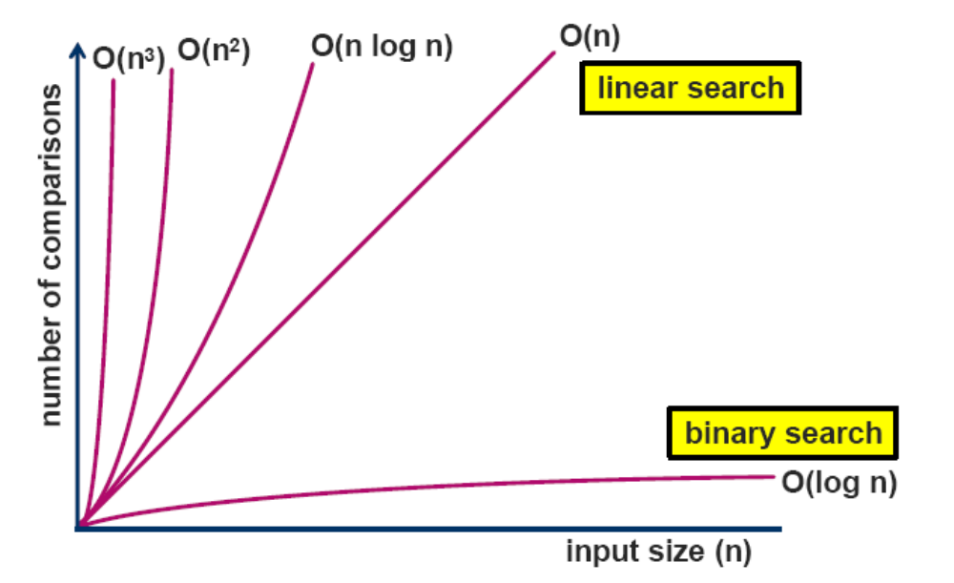
COMPLEXITY CLASSES
Time (steps)

Slide 32
SIZE DOES MATTER[2]
Suppose a program has run time O(n!) and the run time for
  n = 10 is 1 second
  For n = 12, the run time is 2 minutes
  For n = 14, the run time is 6 hours
  For n = 16, the run time is 2 months
  For n = 18, the run time is 50 years
  For n = 20, the run time is 200 centuries

Slide 33
STANDARD ANALYSIS TECHNIQUES
Constant time statements
Analyzing Loops
Analyzing Nested Loops
Analyzing Sequence of Statements
Analyzing Conditional Statements

Slide 34
CONSTANT TIME STATEMENTS
Simplest case: O(1) time statements
Assignment statements of simple data types
int x = y;
Arithmetic operations:
x = 5 * y + 4 - z;
Array referencing:
A[j] = 5;
Array assignment:
∀ j, A[j] = 5;
Most conditional tests:
if (x < 12) ...

Slide 35
ANALYZING LOOPS[1]
Any loop has two parts:
  How many iterations are performed?
  How many steps per iteration?
  int sum = 0,j;
  for (j=0; j < N; j++)
  sum = sum +j;
  Loop executes N times (0..N-1)
  4 = O(1) steps per iteration
Total time is N * O(1) = O(N*1) = O(N)

Slide 36
  int sum = 0,j;
  for (j=n; j >=1; j=j/2)
  sum = sum +j;

Slide 37
  int sum = 0,j;
  For(i=0; i<=n,i++)
  for (j=n; j >=1; j=j/2)
  sum = sum +j;

Slide 38
ANALYZING LOOPS[2]
What about this for loop?
int sum =0, j;
for (j=0; j < 100; j++)
sum = sum +j;
Loop executes 100 times
4 = O(1) steps per iteration
Total time is 100 * O(1) = O(100 * 1) = O(100) = O(1)

Slide 39
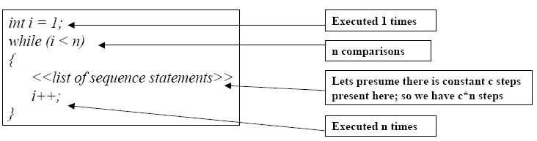
ANALYZING LOOPS – LINEAR LOOPS
Example (have a look at this code segment):
Efficiency is proportional to the number of iterations.
Efficiency time function is :
f(n) = 1 + (n-1) + c*(n-1) +( n-1)
= (c+2)*(n-1) + 1
= (c+2)n – (c+2) +1
Asymptotically, efficiency is : O(n)

Slide 40
ANALYZING NESTED LOOPS[1]
Treat just like a single loop and evaluate each level of nesting as needed:
  int j,k;
  for (j=0; j<N; j++)
  for (k=N; k>0; k--)
  sum += k+j;
Start with outer loop:
  How many iterations? N
  How much time per iteration? Need to evaluate inner loop
Inner loop uses O(N) time
Total time is N * O(N) = O(N*N) = O(N²)

Slide 41
ANALYZING NESTED LOOPS[2]
What if the number of iterations of one loop depends on the counter of the other?
  int j,k;
  for (j=0; j < N; j++)
  for (k=0; k < j; k++)
  sum += k+j;
Analyze inner and outer loop together:
Number of iterations of the inner loop is:
0 + 1 + 2 + ... + (N-1) = O(N²)

Slide 42
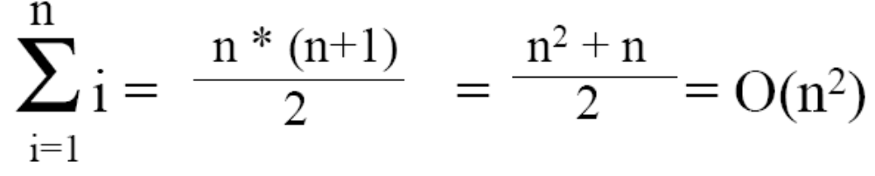
HOW DID WE GET THIS ANSWER?
When doing Big-O analysis, we sometimes have to compute a series like: 1 + 2 + 3 + ... + (n-1) + n
i.e. Sum of first n numbers. What is the complexity of this?
Gauss figured out that the sum of the first n numbers is always:

Slide 43
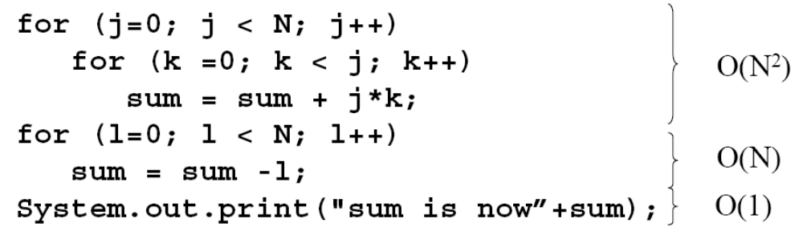
SEQUENCE OF STATEMENTS
For a sequence of statements, compute their complexity functions individually and add them up
Total cost is O(n²) + O(n) +O(1) = O(n²)

Slide 44
CONDITIONAL STATEMENTS
What about conditional statements such as
if (condition)
statement1;
else
statement2;
where statement1 runs in O(n) time and statement2 runs in O(n²) time?
We use "worst case" complexity: among all inputs of size n, what is the maximum running time?
The analysis for the example above is O(n²)

Slide 45
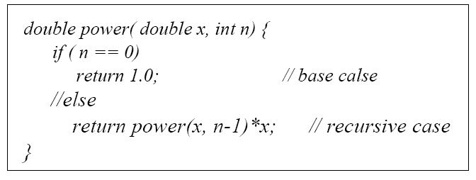
DERIVING A RECURRENCE EQUATION
So far, all algorithms that we have been analyzing have been non recursive
Example : Recursive power method
If N = 1, then running time T(N) is 2
However if N ≥ 2, then running time T(N) is the cost of each step taken plus time required to compute power(x,n-1). (i.e. T(N) = 2+T(N-1) for N ≥ 2)
How do we solve this? One way is to use the iteration method.

Slide 46
ITERATION METHOD
This is sometimes known as “Back Substituting”.
Involves expanding the recurrence in order to see a pattern.
Solving formula from previous example using the iteration method :
Solution : Expand and apply to itself :
Let T(1) = n0 = 2
T(N) = 2 + T(N-1)
= 2 + 2 + T(N-2)
= 2 + 2 + 2 + T(N-3)
= 2 + 2 + 2 + ……+ 2 + T(1)
= 2N + 2 remember that T(1) = n0 = 2 for N = 1
So T(N) = 2N+2 is O(N) for last example.

Slide 47
SUMMARY
Algorithms can be classified according to their complexity => O-Notation
  only relevant for large input sizes
"Measurements" are machine independent
  worst-, average-, best-case analysis

Slide 48
REFERENCES
Introduction to Algorithms by Thomas H. Cormen
Chapter 3 (Growth of Functions)

